Slide 1
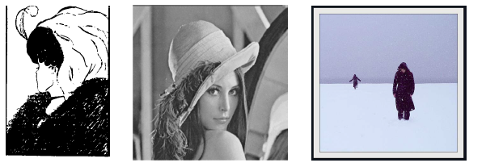
Introduction
Image Types:
Binary
Gray Scale
Color
Slide Credit: Professor Mubarak Shah

Slide 2
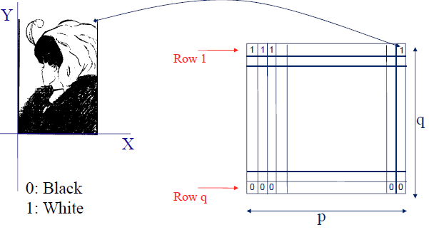
Binary Image

Slide 3
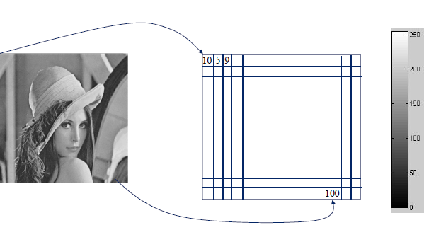
Gray Level Image

Slide 4
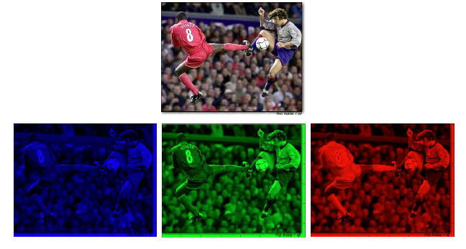
Color Image
Blue
Green
Red

Slide 5
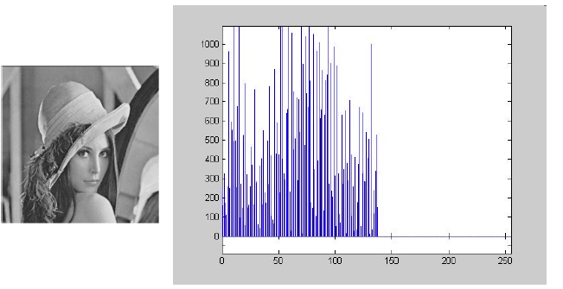
Image Histogram

Slide 6
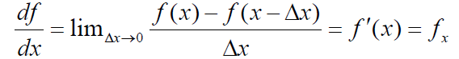
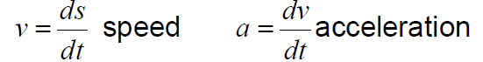
Derivatives
Derivatives: Rate of changes
speed is a rate of change of distance
acceleration is a rate of change of speed.

Slide 7
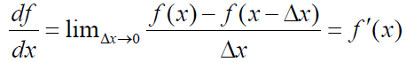
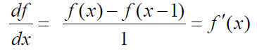
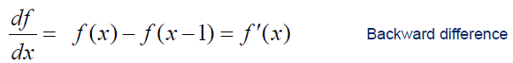
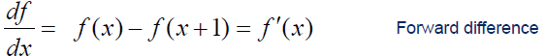
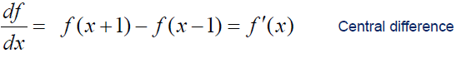
Discrete Derivatives

Slide 8
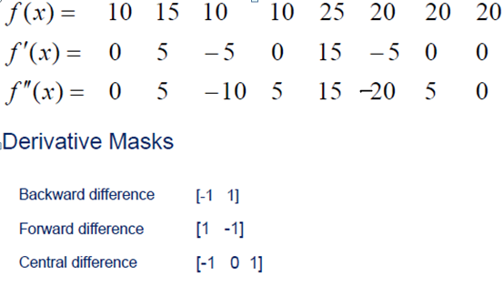
Example of Discrete Derivatives

Slide 9
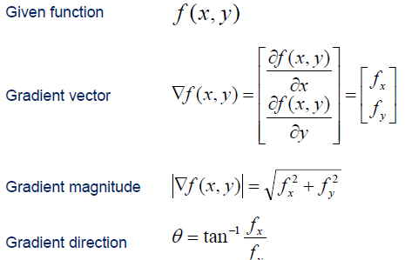
Discrete Derivatives in 2D

Slide 10
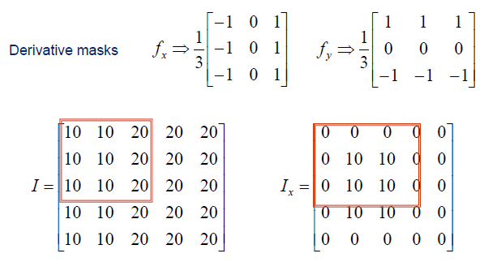
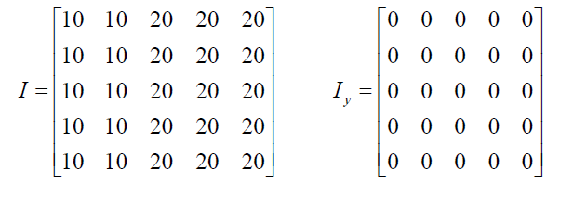
Derivatives of Images

Slide 11
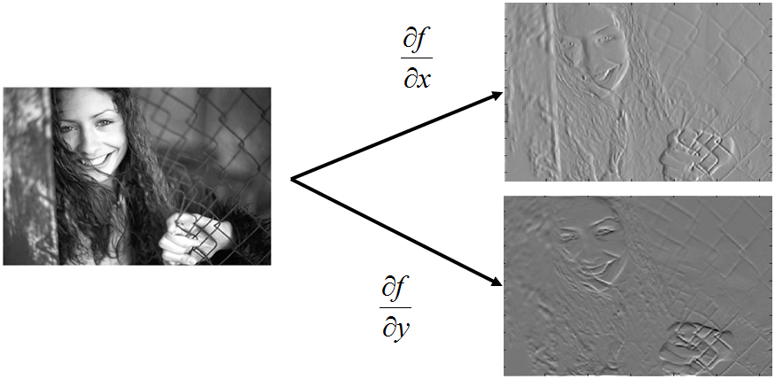
Derivatives of Image

Slide 12
Noise
Images are corrupted by random variations in intensity values called noise due to non-perfect camera acquisition or environmental conditions.
Assumptions:
Additive noise: a random value is added at each pixel
White noise: The value at a point is independent on the value at any other point.

Slide 13
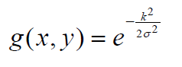
Common Types of Noise
Salt and pepper noise: random occurrences of both black and white intensity values
Impulse noise: random occurrences of white intensity values
Gaussian noise: impulse noise but its intensity values are drawn from a Gaussian distribution
noise intensity value:
k: random value in [a,b]
σ: width of Gaussian
models sensor noise (due to camera electronics)

Slide 14
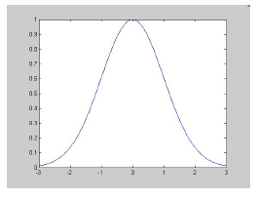
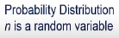
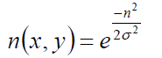
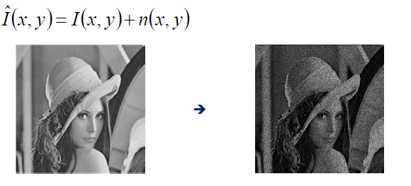
Image Noise
Light Variations.
Camera Electronics
Surface Reflectance
Lens
I(x,y): the true pixel values
n(x,y): noise at pixel (x,y)

Slide 15
Example of Noisy Images

Slide 16
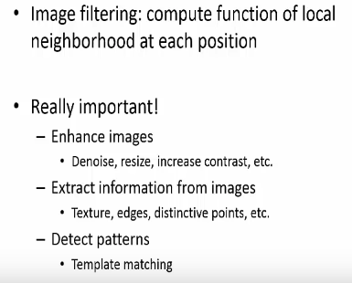
Image filtering

Slide 17
Image filtering
Modify the pixels in an image based on some function of a local neighborhood of each pixel.
applying different weights for different neighboring pixels
10
5
3
Some function
4
5
1
7
1
1
7
Local image data
Modified image data
Source: L. Zhang

Slide 18
Linear filtering
One simple version: linear filtering (cross-correlation, convolution)
Replace each pixel by a linear combination of its neighbors
The prescription for the linear combination is called the “kernel” (or “mask”, “filter”)
10
5
3
0
0
0
4
6
1
0
0.5
0
8
1
1
8
0
1
0.5
Local image data
kernel
Modified image data
Source: L. Zhang

Slide 19
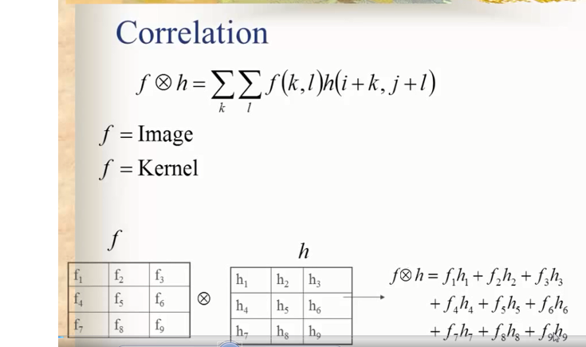

Slide 20
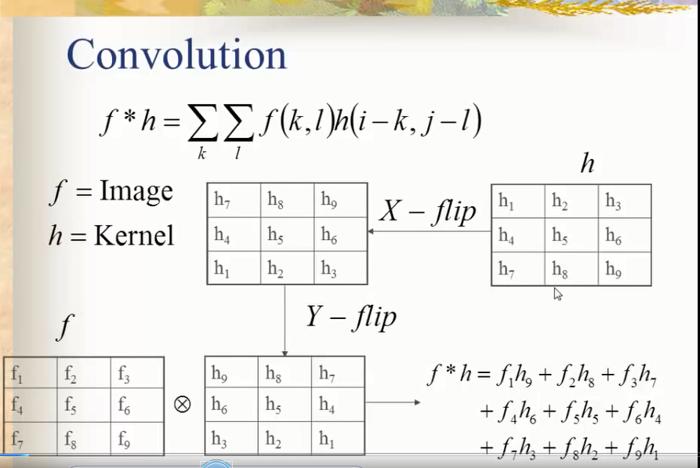
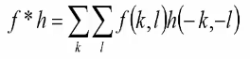

Slide 21



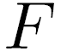
Convolution
Adapted from F. Durand

Slide 22
Noise Filtering
Basic Idea: replace each pixel intensity value with a new value taken over a neighborhood of fixed size
Mean filter
Median filter
The size of the filter controls degree of smoothing

Slide 23
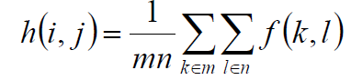
Mean Filter
Take the average of intensity values in a m x n region of each pixel (usually m = n)
– take the average as the new pixel value
the normalization factor mn preserves the range of values of the original image

Slide 24
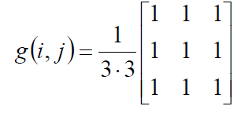
Mean Filtering as Convolution
Compute the convolution of the original image with
– simple filter, the same for all types of noise
– disadvantage: blurs image, detail is lost

Slide 25
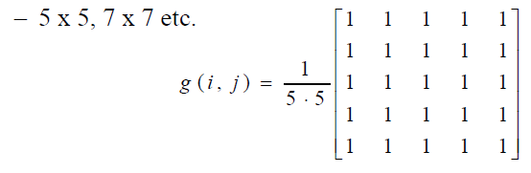
Size of Filter
The size of the filter controls the amount of filtering (and blurring).
– different weights might also be used
– normalize by sum of weights in filter

Slide 26
Effect of Mean Filter

Slide 27
Median Filter
Replace each pixel value with the median of the gray values in the region of the pixel:
1. take a 3 x 3 (or 5 x 5 etc.) region centered around pixel (i,j)
2. sort the intensity values of the pixels in the region into ascending order
3. select the middle value as the new value of pixel (i,j)

Slide 28
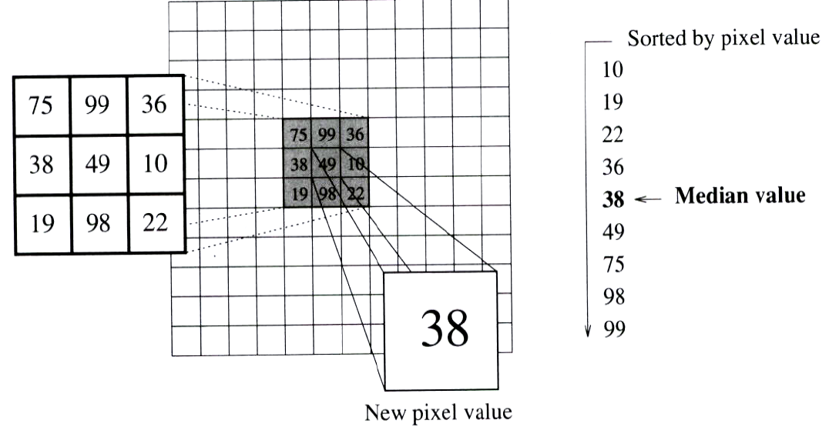
Computation of Median Filter
Very effective in removing salt and pepper or impulsive noise while preserving image detail
Disadvantages: computational complexity, non linear filter

Slide 29
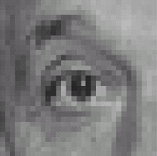
Linear filters: examples
*
0
0
0
=
0
1
0
0
0
0
Original
Identical image
Source: D. Lowe

Slide 30
Linear filters: examples
*
0
0
0
=
1
0
0
0
0
0
Original
Shifted right
By 1 pixel
Source: D. Lowe

Slide 31
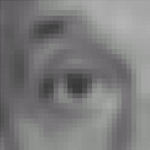

Linear filters: examples
*
1
1
1
=
1
1
1
1
1
1
Original
Blur (with a mean filter)
Source: D. Lowe

Slide 32
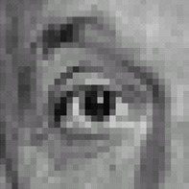



Linear filters: examples
*
0
0
0
-
1
1
1
=
0
2
0
1
1
1
0
0
0
1
1
1
Sharpening filter (accentuates edges)
Original
Source: D. Lowe

Slide 33
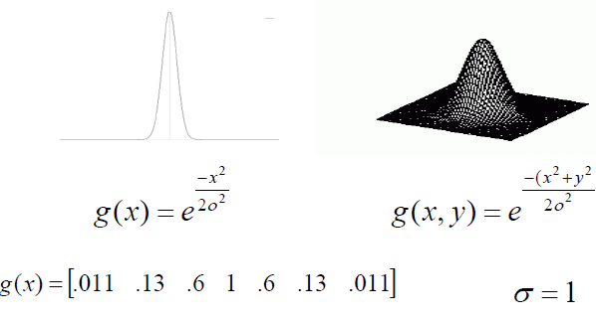
Gaussian Filter

Slide 34
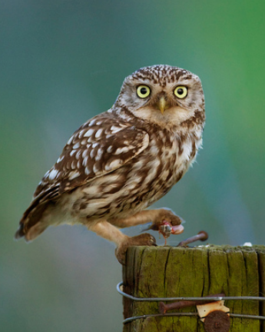
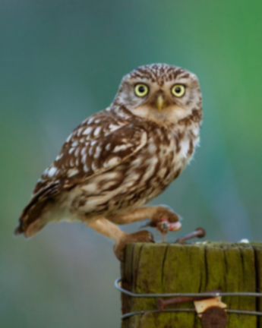








Gaussian filters
= 1 pixel
= 5 pixels
= 10 pixels
= 30 pixels

Slide 35


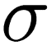
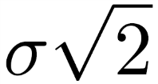
Gaussian filter
Removes “high-frequency” components from the image (low-pass filter)
Convolution with self is another Gaussian
Convolving two times with Gaussian kernel of width = convolving once with kernel of width
*
=
Source: K. Grauman
Notes:
Linear vs. quadratic in mask size

Slide 36
Properties of Gaussian Filters
Most Common natural Model.
Smooth function, it has infinite number of derivatives.
Fourier Transform of Gaussian is also Gaussian.
Convolution of Gaussian itself is a Gaussian.
There is cells in our retina using Gaussian Filters techniques to filtered out different visions.

Slide 37
Comparisons

Slide 38
Edge Detection

Slide 39
Levels of reasoning in vision
Scenes
Objects
Lines
Edges
Pixels
Images

Slide 40
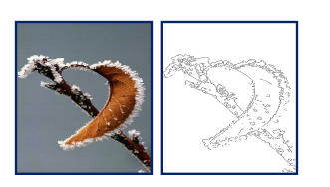
Edges
Abrupt change in the intensity pixels.
Discontuinuty in image brightness or contrast.
Usually edges on the boundary of two region.

Slide 41
Edge Detection
Process of identifying edges in an image to be used as a fundamental asset in image analysis.
Locating areas with strong intensity contrasts.

Slide 42
Why is Edge Detection Useful?
Important features can be extracted from the edges of an image (e.g., corners, lines, curves).
These features are used by higher-level computer vision algorithms (e.g., recognition).
object recognition
image matching (e.g., stereo, mosaics)
document analysis
horizon detection
line following robots
and many more apps

Slide 43
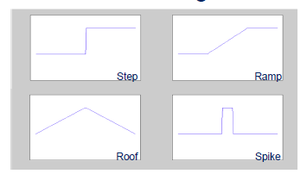
Edge Types

Slide 44
Edge Detection Background
Classical gradient edge detection
Sobel
Prewitt
Gaussian based filter
Gradient of Gaussian (Canny)
Laplacian of Gaussian (Marr-Hardreath)

Slide 45
Edge detection algorithm
Smoothing: suppress as much noise as possible, without destroying true edges.
Enhancement: apply differentiation to enhance the quality of edges (i.e., sharpening).
Detection: Which to discard and which to maintain.
Thresholding.
Localization: determine the exact location of an edge.
Edge thinning and linking are usually required in this step.

Slide 46
Prewitt and Sobel Detector
Compute derivatives
In x and y
Find gradient magnitude
Threshould gradient magnitude.

Slide 47
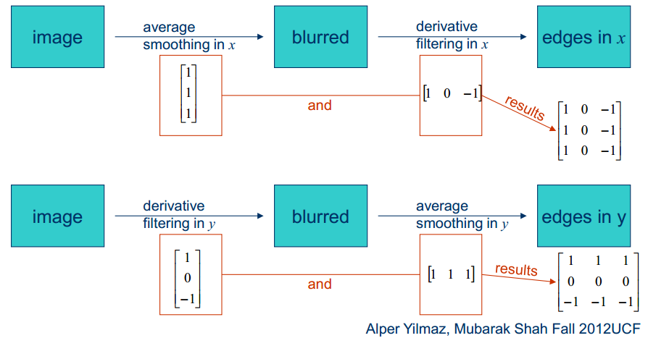
Prewitt Edge Detector

Slide 48
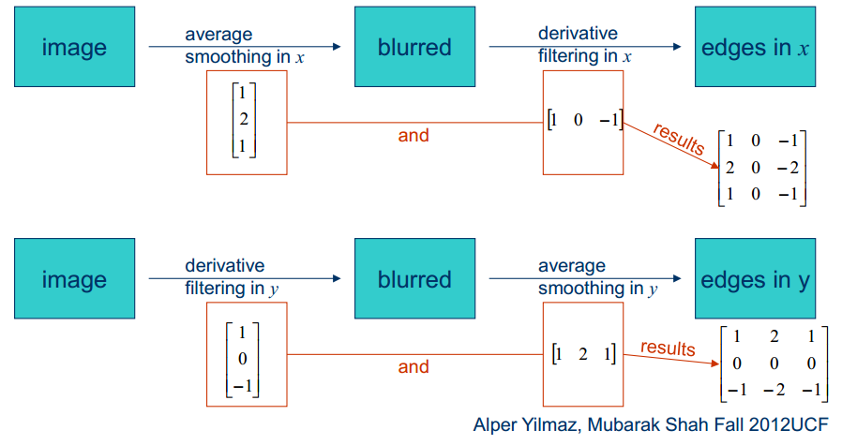
Sobel Edge Detector

Slide 49
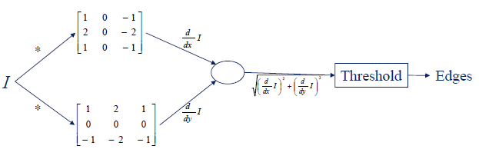
Sobel Edge Detector

Slide 50
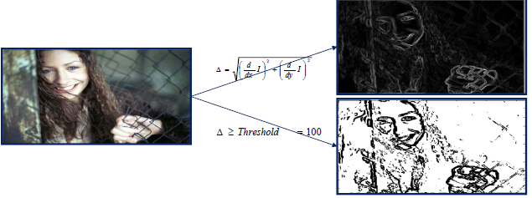
Sobel Edge Detector

Slide 51
Canny Edge Detector Steps
Steps:
Smooth image with Gaussian filter
Compute derivative of filtered image
Find magnitude and orientation of gradient
Apply “Non-maximum Suppression”
Apply “Hysteresis Threshold”

Slide 52
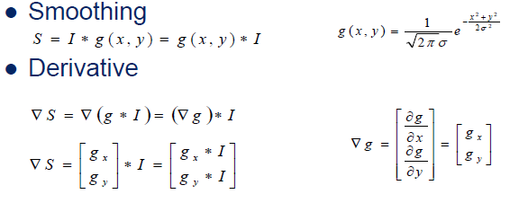
Canny Edge Detector
First Two Steps

Slide 53
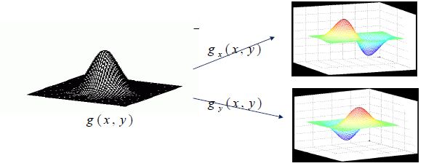

Slide 54
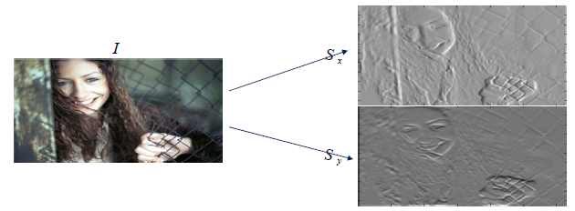
Canny Edge Detector
First Two Steps

Slide 55
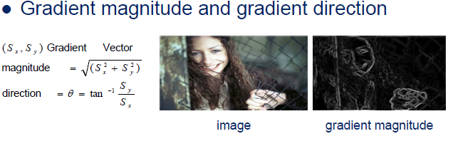
Canny Edge Detector
Third Steps

Slide 56
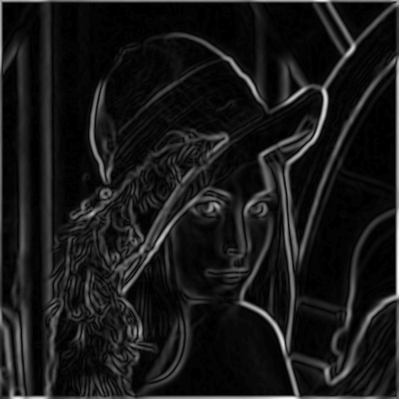

Canny Edge Detector
Fourth Steps
Non Maximum Supression:
Check if gradient magnitude at pixel location (i, j) is local maximum along gradient direction.

Slide 57


Canny Edge Detector
Non Maximum Supression

Slide 58


Hysteresis thresholding
Standard thresholding:
- Can only select “strong” edges.
- Does not guarantee “continuity”.
gradient magnitude
low threshold
high threshold

Slide 59

Hysteresis thresholding (cont’d)
Hysteresis thresholding uses two thresholds:
- low threshold t_{l}
- high threshold t_{h} (usually, t_{h} = 2t_{l})
t_{h}
t_{l}
t_{h}
t_{l}
For “maybe” edges, decide on the edge if neighboring pixel is a strong edge.

Slide 60
Hysteresis thresholding/Edge Linking
Idea: use a high threshold to start edge curves and a low threshold to continue them.
Use edge
“direction” for
linking edges

